Slide 1


Proposal for sponsorship
<< Chapter Name >>

Slide 2
Introduction
The purpose of this presentation is to assist student veterans in securing donors to help fund their registration and/or travel to Student Veterans of America’s National Conference (NatCon).
Parts of this presentation are preset for the chapter to use. Slides with red markers on the bottom are slides that are to be created by the chapter.
<< This slide is for the chapter to reference. >>

Slide 3
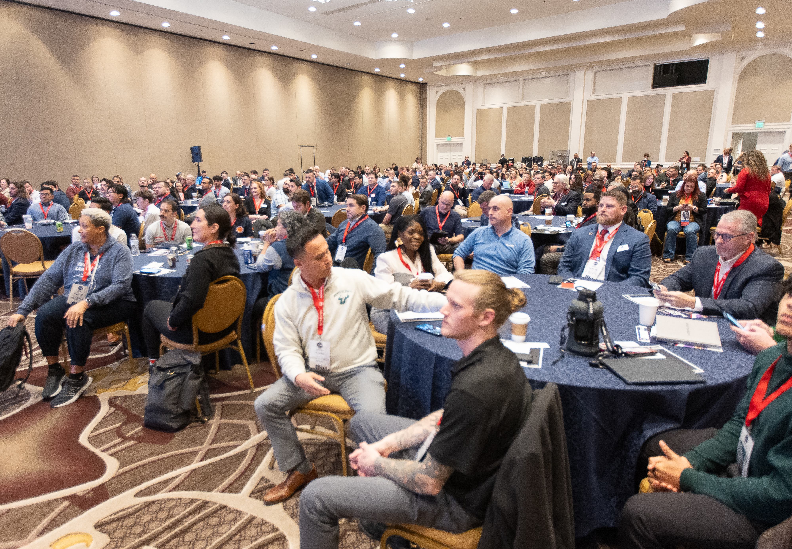
What is Student Veterans of America?
Student Veterans of America (SVA) is the premier organization leading service, research, programs, and advocacy for veterans in higher education.
Our Vision
  Empowering student veterans to lead and live their best lives.
Our Mission
  Act as a catalyst for student veteran success by providing resources, network support and advocacy to, through, and beyond higher education.

Slide 4
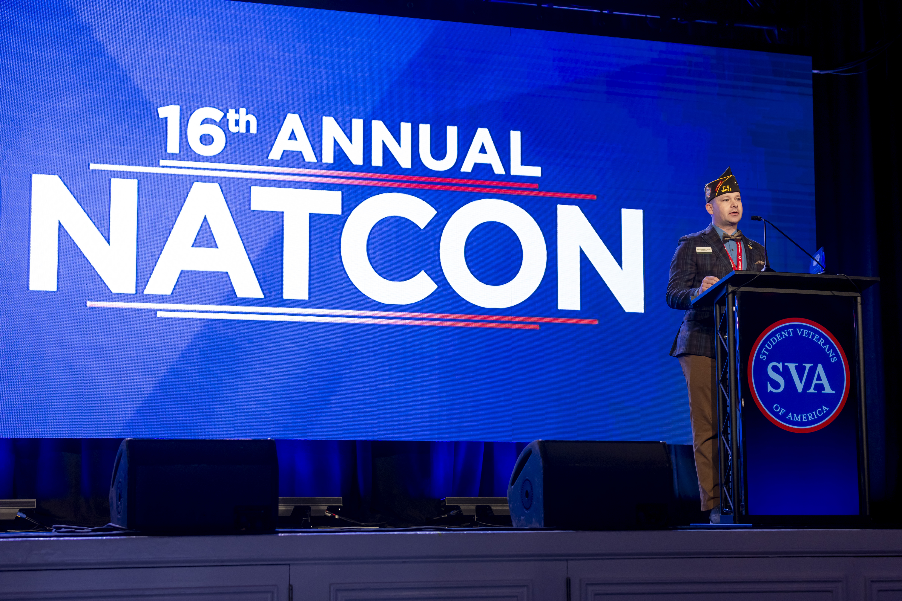
What is NatCon?
The SVA National Conference (“NatCon” as we like to call it) is the largest gathering of student veterans anywhere in the world.
It is an annual event that brings together student veterans, higher education professionals, and other stakeholders in the veterans' community to learn, network, and share best practices.

Slide 5
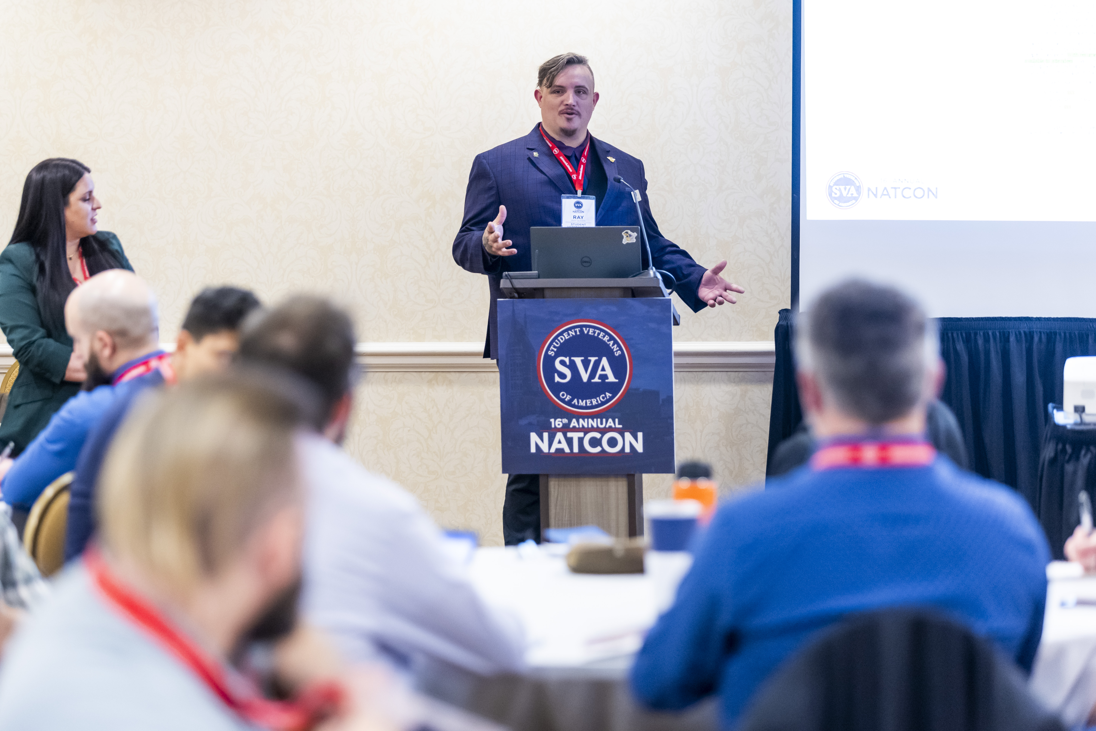
Why Attend NatCon?
Providing educational resources:
  SVA’s National Conference offers a range of educational sessions on topics like leadership development, mental health, and career readiness.
  These sessions provide student veterans with the tools and knowledge they need to succeed both in college and beyond.

Slide 6
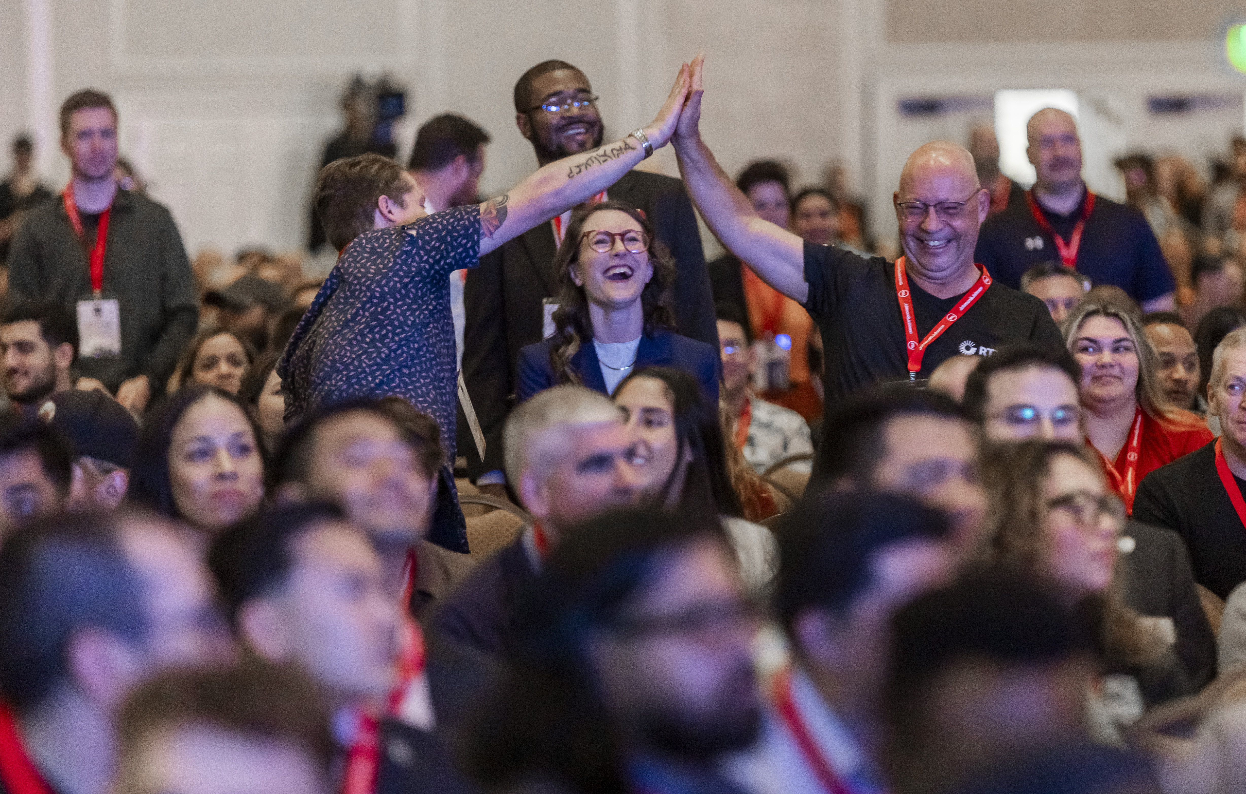
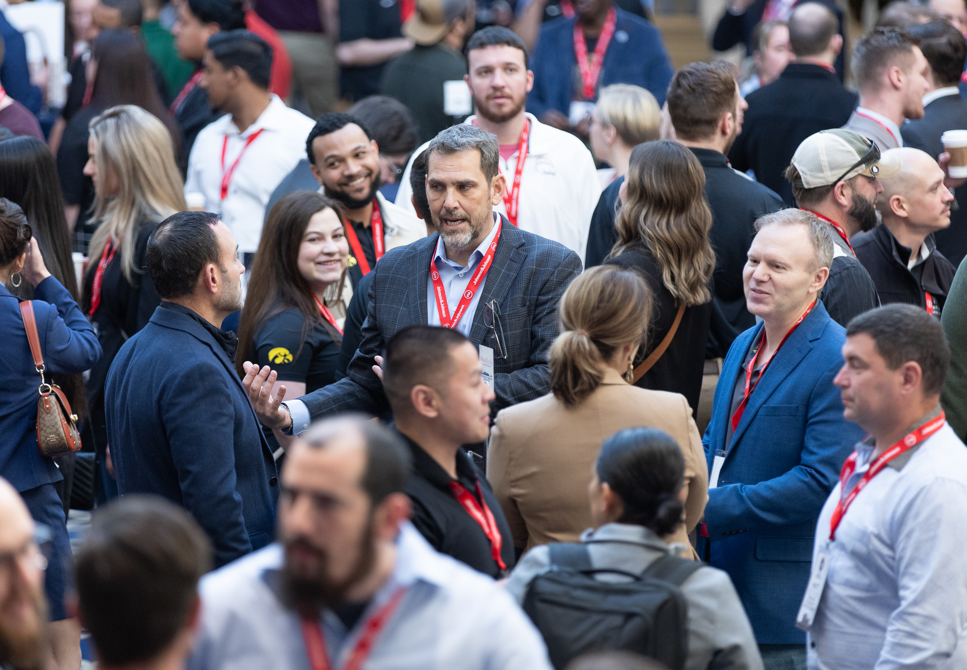
Why Attend NatCon?
Building a sense of community:
  For many student veterans, SVA’s National Conference is a chance to connect with others who have shared experiences. The conference offers numerous opportunities for networking and socializing, and many attendees report feeling a sense of camaraderie and support.

Slide 7
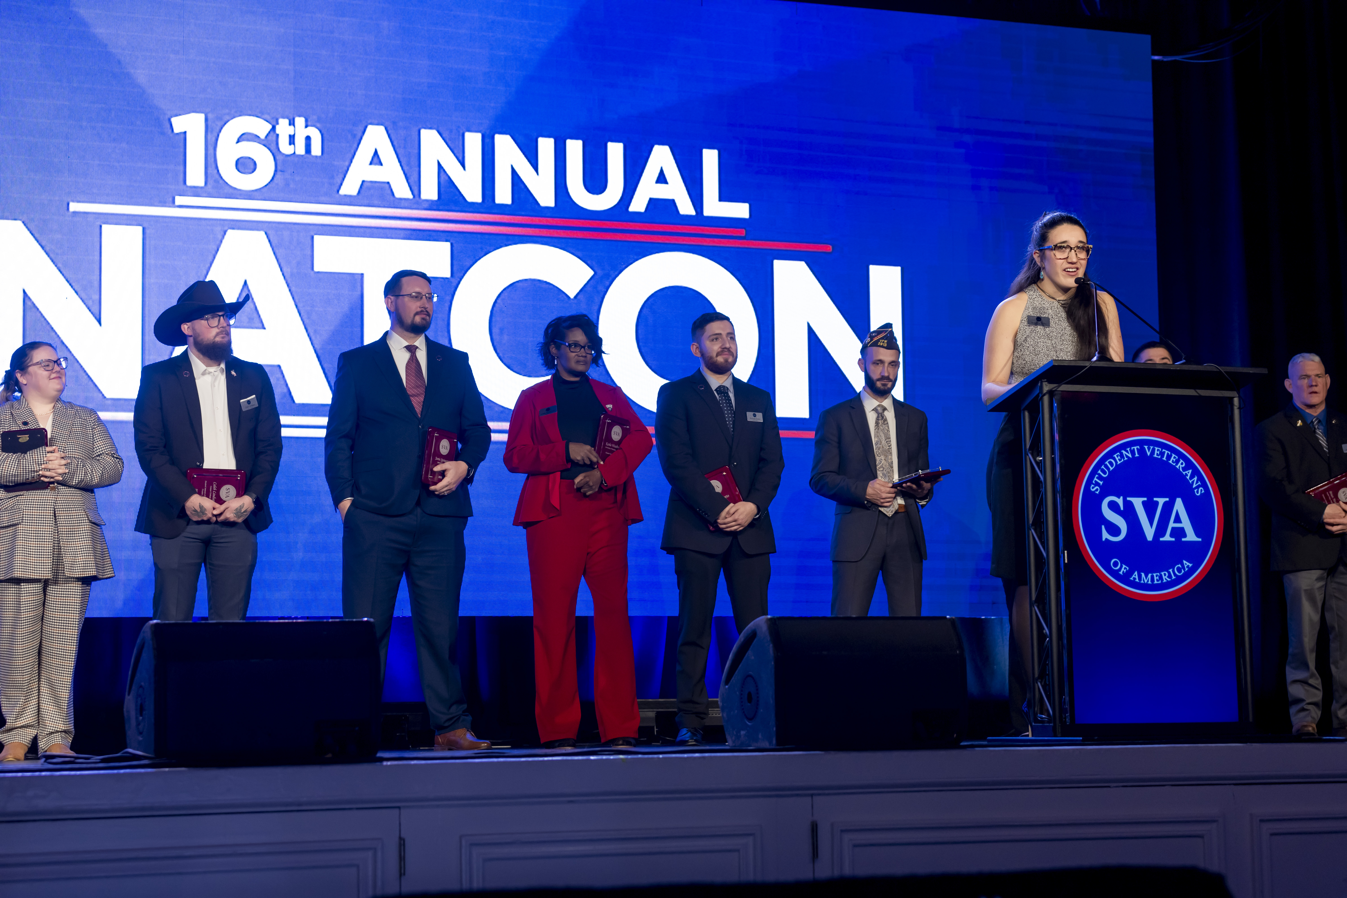
Why Attend NatCon?
Recognizing outstanding leaders:
  Each year, the SVA National Conference includes an awards ceremony to recognize student veterans and higher education professionals who have made exceptional contributions to the veterans' community.
  These awards provide well-deserved recognition for individuals who have gone above and beyond in supporting student veterans.

Slide 8
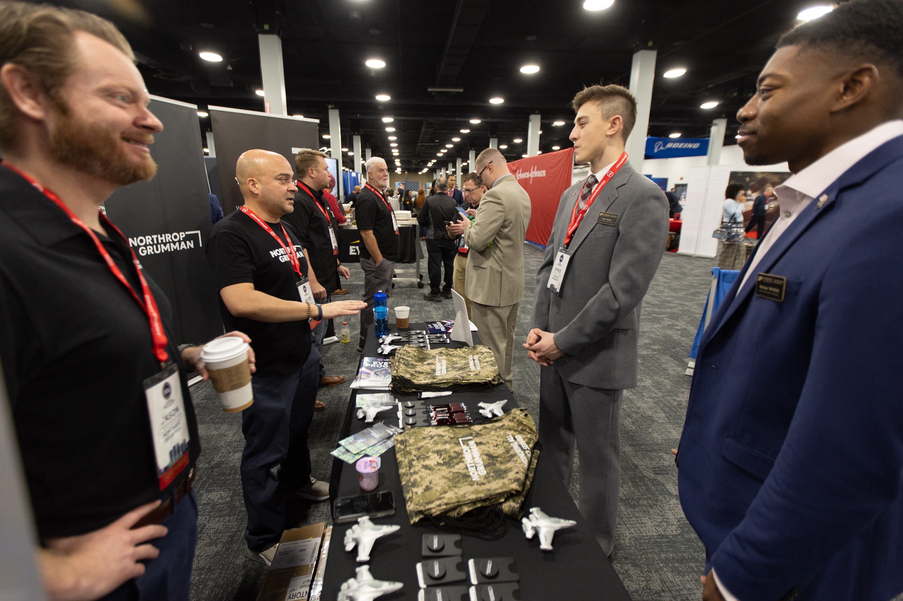
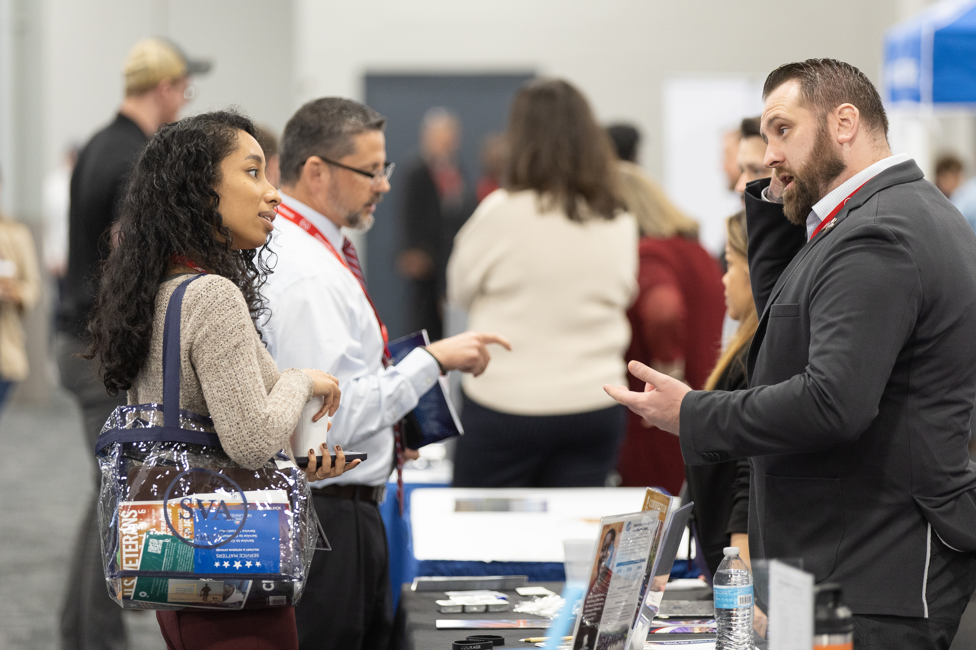
Why Attend NatCon?
Connecting veterans with job potential employers:
  Many companies and organizations attend the SVA National Conference to recruit student veterans for internships and full-time jobs.

Slide 9
Why Attend NatCon?
<< This is your chance if you attended NatCon in the past to share your or your chapter’s personal NatCon experience. >>

Slide 10
How much does it cost?
<< In this section you will explain to the potential donor how much it will cost to send you your chapter to NatCon. It is important to itemize each cost (i.e. flights, hotel, registration). Some donors may decide to cover all cost. Some may decide to pay for one category. Use the NatCon Chapter Cost Estimator on NatCon.StudentVeterans.org to help you create this slide>>

Slide 11
Conclusion of presentation
Thank the potential sponsor or donor for their time. They gave up time in their day for you.
Remind them that no contribution is too small.
<< This slide is for the chapter to reference. >>

Slide 12
Follow up
If someone makes a donation or sponsors you or your chapter, make sure to follow up with them with a thank you note for their support.
Address the person by name, and reference the amount received and remind them how that money is going to be used.
<< This slide is for the chapter to reference. >>

Slide 13
Follow up After Natcon
After NatCon share your experience with those who made a contribution. Tell them about the unique experience you had and include appropriate pictures. Thank them again for their contribution and invite them to get involved with your chapter in other ways.
<< This slide is for the chapter to reference. >>

Slide 14
Conclusion
Student Veterans of America is excited to see you at our 17th Annual NatCon in Colorado Springs, Colorado.
If you or your chapter has any questions on this presentation or NatCon please contact us at programs@studentveterans.org.
<< This slide is for the chapter to reference. >>

Slide 15
Proposal for sponsorship
<< Chapter Name >>

